Slide 1
CUSTOMER CHURN ANALYSIS IN BANKING SECTOR
BY,
Alok Singh
Rohan Sharma
Dhiraj Landge
Shriram Sankaranarayanan
Aseem Salim
Atharva Joshi – not helped in project
GROUP 8

Slide 2
ABSTRACT
This research project uses a predictive analytics model to analyze and reduce client churn in the banking sector.
This study explores factors such as borrowing costs, demographics, bank balances, and infrastructure.
The study utilizes a database of 10,000 bank customers' detailed information, focusing on factors such as financial health, demographics, and banking activities.
Models like logistic regression, decision trees, random forests, and neural networks will be employed to predict churn based on factors like credit score, age, spending, product role, credit card ownership, activity level, and salary expectations.
Significance analysis will identify predictors with the greatest impact.
The goal is to enhance client relationships, engagement tactics, and overall bank performance while reducing acquisition costs.

Slide 3
PROBLEM DEFINITION
Customer churn in banking refers to the loss of customers due to reasons like dissatisfaction, better offers from competitors, changing client needs, or a decline in the bank's brand image.
Since acquiring new customers is costly, churn can significantly impact a bank's revenue and market share.
High turnover rates also harm a bank's reputation and customer loyalty.
Recognizing and addressing the root causes of churn is crucial for maintaining a stable and satisfied customer base.

Slide 4
PROBLEM STATEMENT
Find the chances of whether a customer will churn or not.
Find predictors which are influencing customer churn.
What can be done to avoid customer churn?
How to retain existing customers as getting new customers have more cost associated with compared to retaining the existing customers?

Slide 5
DATA COLLECTION
The dataset used for banking customer churn analysis is sourced from kaggle, representing a curated collection compiled from various banking organizations.
It includes extensive consumer information, encompassing financial indicators like credit scores, as well as personal data such as age, gender, and location.
Rownumber and customerid are two examples of key identifiers that uniquely identify each entry.
The 'exited' variable is crucial.
The dataset serves as a valuable source for researching customer churn dynamics in the banking industry.

Slide 6
DATA DESCRIPTION
The 'churn.Csv' dataset focuses on predicting customer churn in banking, containing detailed information about 10,000 customers.
It includes numerical and categorical variables such as credit score, age, geography, and gender.
Financial attributes like balance, credit card ownership, and salary are crucial for understanding customer behavior.
The dataset reveals diverse customer profiles, with variations in credit scores, demographics, and banking habits
Utilizing predictive analytics models, such as logistic regression or decision trees, can help forecast churn likelihood based on customer data.
Feature importance analysis within these models identifies key predictors influencing churn.
The dataset highlights areas for the bank to improve customer engagement and retention, addressing the 20.37% churn rate.
By analyzing this data, we can observe the diverse financial profiles of customers and their interactions with the bank, identify patterns influencing customer churn, and use predictive analytics models to forecast the likelihood of churn based on factors like credit score, activity level, and balance.

Slide 7
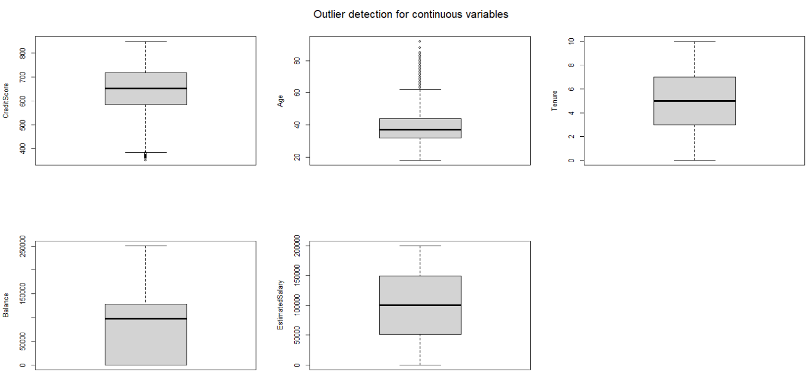
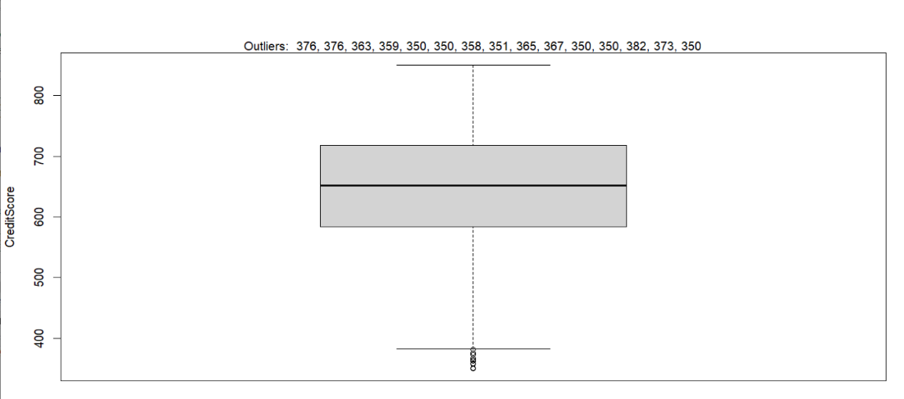
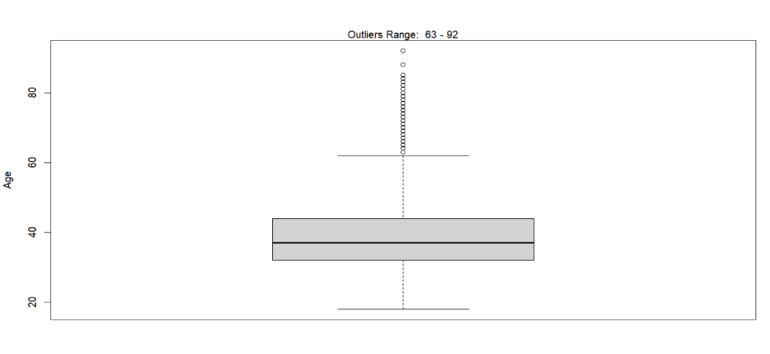
EXPLORATORY DATA ANALYSIS

Slide 8
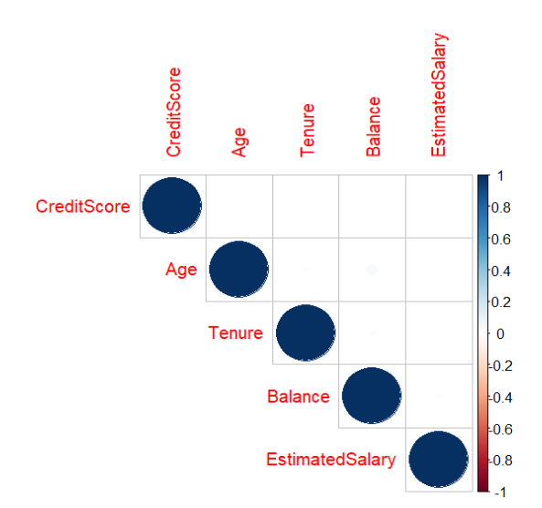
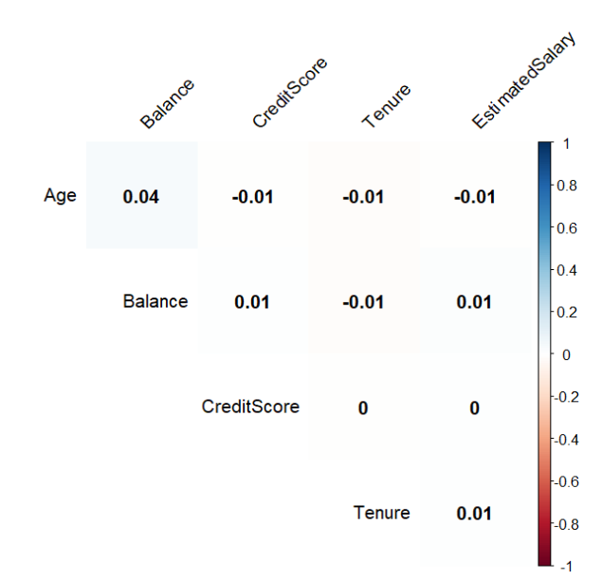
EXPLORATORY DATA ANALYSIS

Slide 9
MODEL SELECTION
Various machine learning algorithms, including gradient boosting, k-nearest neighbors (KNN), and support vector machine (SVM), are employed to predict customer churn in a banking dataset.
The gradient boosting model, built with xgboost, demonstrates robustness with an accuracy of 85.63%. KNN, known for its simplicity, achieves 84.62% accuracy, emphasizing the importance of feature scaling and neighbor selection.
SVM, particularly when focused on essential variables identified by decision tree analysis, outperforms with the highest accuracy of 87.52%, emphasizing the importance of precise feature selection for optimal model performance in banking customer retention efforts.
Svm, applied to the entire dataset and a subset of critical variables, attains accuracies of 87.22% and 87.52%, respectively, showcasing the significance of precise feature selection.
The svm model focusing on key variables from decision tree analysis emerges as the most accurate and interpretable choice for banking customer retention.

Slide 10
MANAGERIAL DISCUSSION
The improved support vector machine (SVM) model, utilizing critical variables from decision tree analysis, outperformed standard SVM, gradient boosting, and k-nearest neighbors (KNN) in predicting customer churn with an accuracy of 87.52%.
This highlights the importance of precise feature selection in developing specialized client retention strategies for banks.
The insights obtained enable more effective resource allocation, directing efforts towards areas with the greatest impact on retention, leading to cost savings and operational efficiency.
The study underscores the significance of data-driven decision-making in the banking industry, showcasing how advanced prediction models can guide strategic choices and provide a competitive advantage.
Continuous refinement of predictive models and monitoring consumer behavior factors are crucial for staying ahead in the dynamic banking industry and maintaining a loyal client base.

Slide 11
THANKYOU

